Slide 1
HIGH LOW METHOD
Ch 22

Slide 2
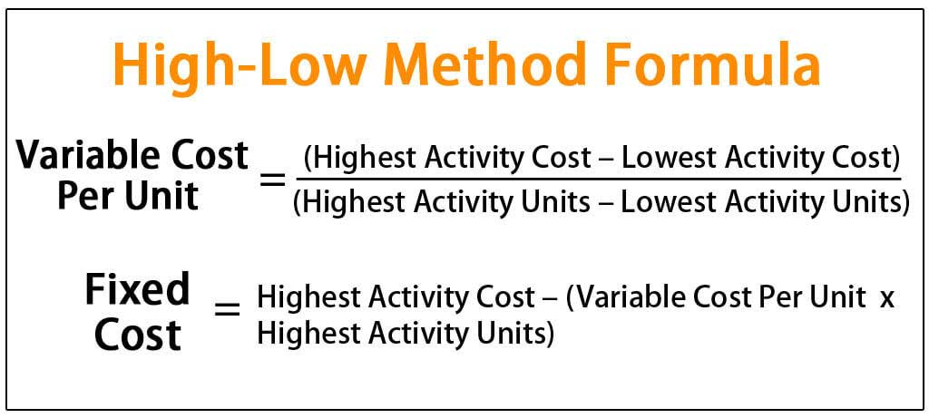
Y=mx+c (we have to find m and C)

Slide 3
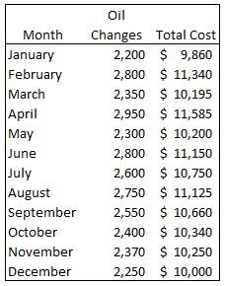
HIGH LOW METHOD
Here highest activity ( in terms of oil changes) is in the month of april and lowest activity is in the month January

Slide 4
VCU or m =($11585-$9860 )/(2950 -2200 ) (Jan & apr)
VCU= 1725/750 =$2.3
Total Fixed Cost we know y=mx+c; y= 2.3*x+c
Use only the months jan and april in his case
Using jan information:
9860=(2.3*2200)+c ; or 9860-5060=c ;so c= 4800
Cost equation:
Y=mx+c; Here y = total cost, mx= Total variable cost, c = Total Fixed Cost. Thus m = variable cost per unit.
Y = 2.3x + 4800
If x = 3000 find tc
TC= (2.3*3000)+4800 = $11 ,700

